Slide 1

Rear Parking Collision-Avoidance
Assist System
“후방주차 충돌방지 시스템＂
SWIP” 5st Team 4
Youngchan Jung , Chae Jongyoon , Junho Hwang , Hyelin Jung
2023. 03. 27 (Day 3)

Slide 2
Contents
Introduction
H/W & S/W Configuration
Demo Scenarios Conclusion

Slide 3


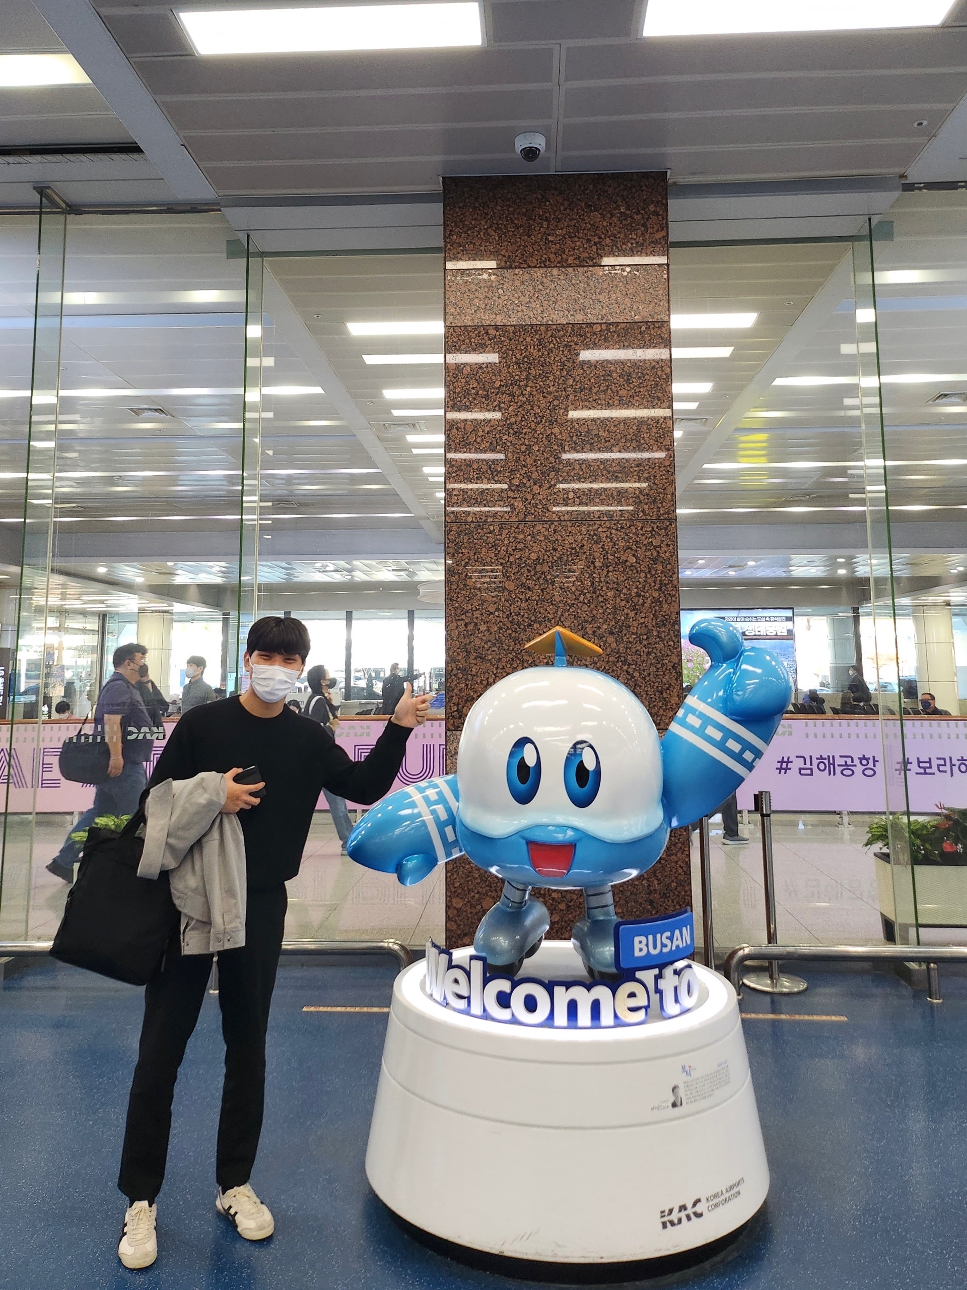
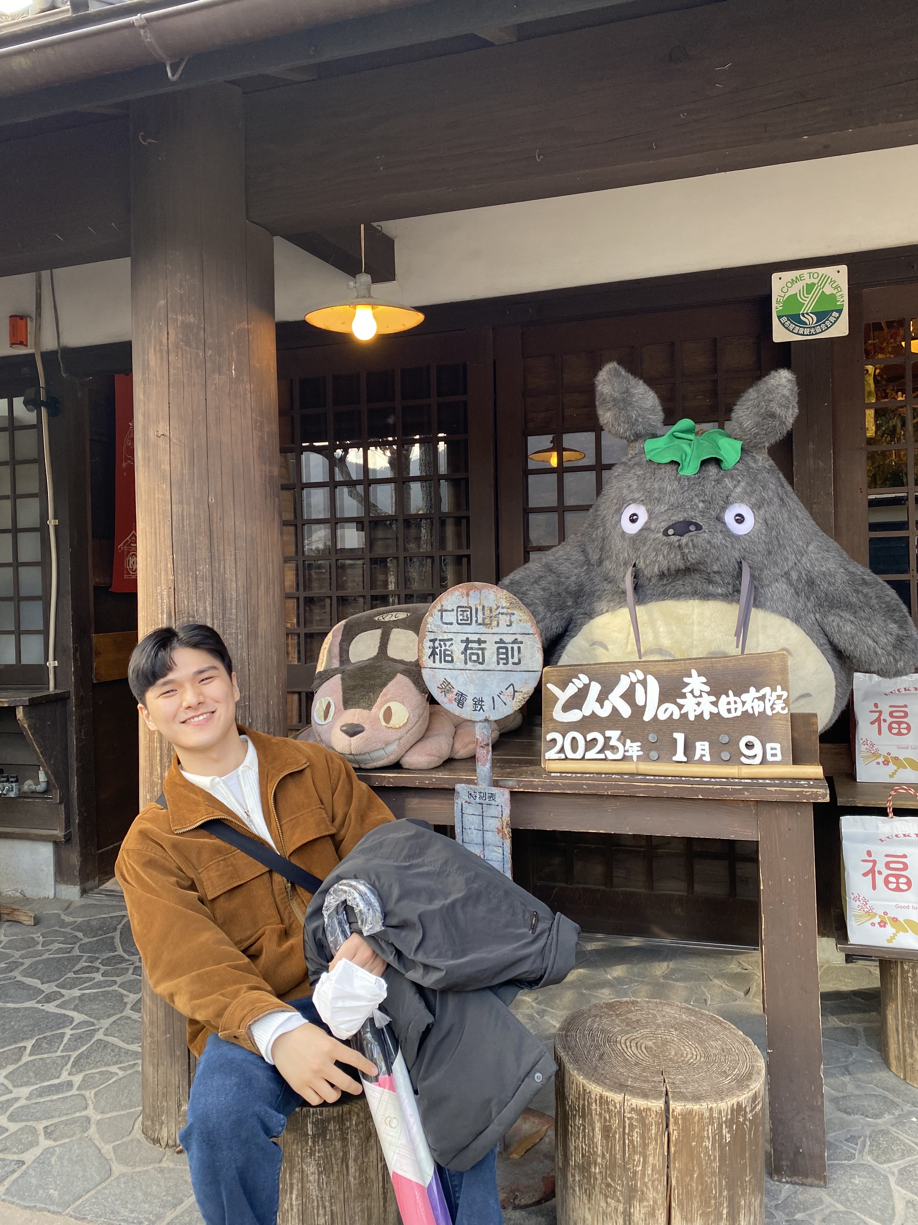

Introduction
Team Members (* means team leader)
Junho Hwan${\text{g}}^{∗}$
Hyelin Jung
Jongyoon Chae
Youngchan Jung
Team Leading Writing Docs
Control Section
Detection Section
Control Section Writing Docs
Control Section Detection Section Writing Docs
Detection Section Writing Docs

Slide 4
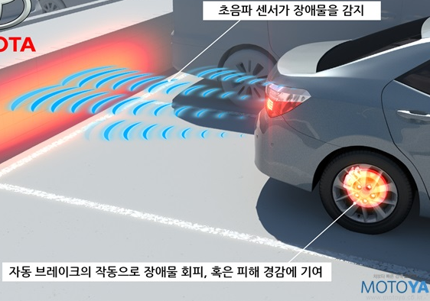

Introduction
Rear Parking Collision-Avoidance Assist System
Rear parking assistance system using ultrasonic sensors
ADVANTAGES
Prevent pedal misoperation
Prevention of personnel accidents
Reduced driver fatigue

Slide 5

Introduction
Obstacle detection & Warning Signal according to distance
30 cm ~ : Obstacle detection x
20~30 cm : Obstacle detection(Blue) & No Warning Signal
10~20 cm : Obstacle detection(Green) & Weak Warning Signal(Low Tone & Frequency)
~ 10 cm : Obstacle detection(Red) & Strong Warning Signal(High Tone & Frequency)
~10cm : Red light ON & Beep
10~20cm : Blue light ON & Beep
20~30cm : Blue light ON

Slide 6
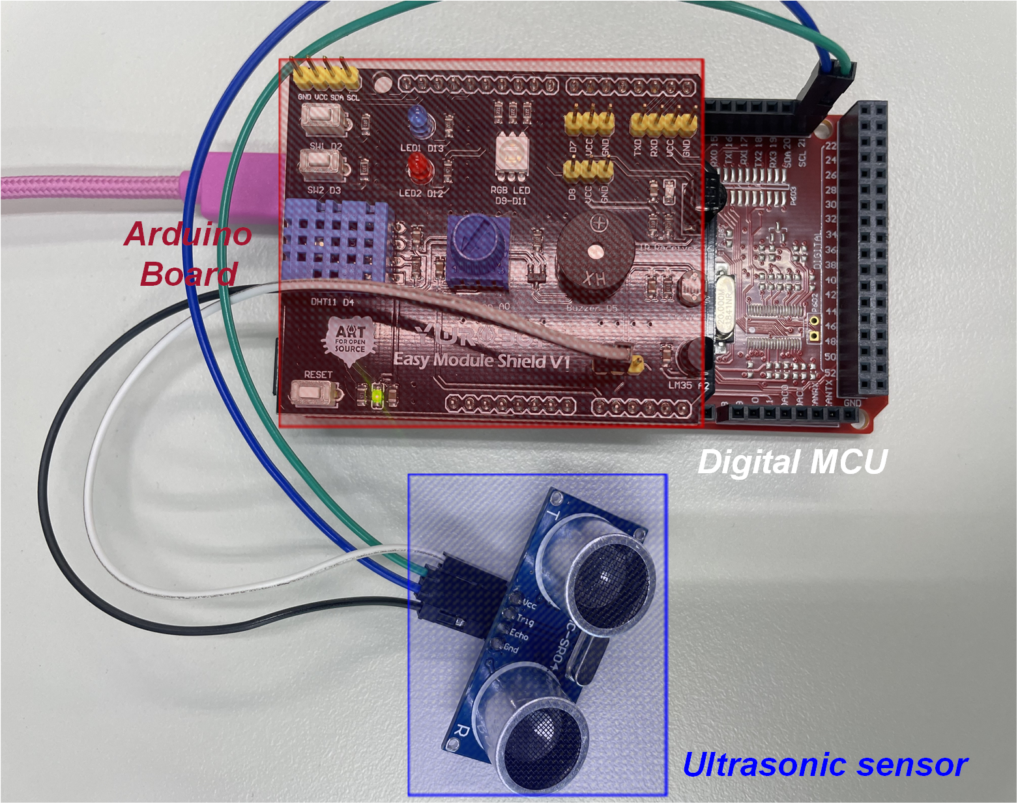
H/W & SW Configuration
Hardware Configuration
[ Hardware Configuration ]

Slide 7
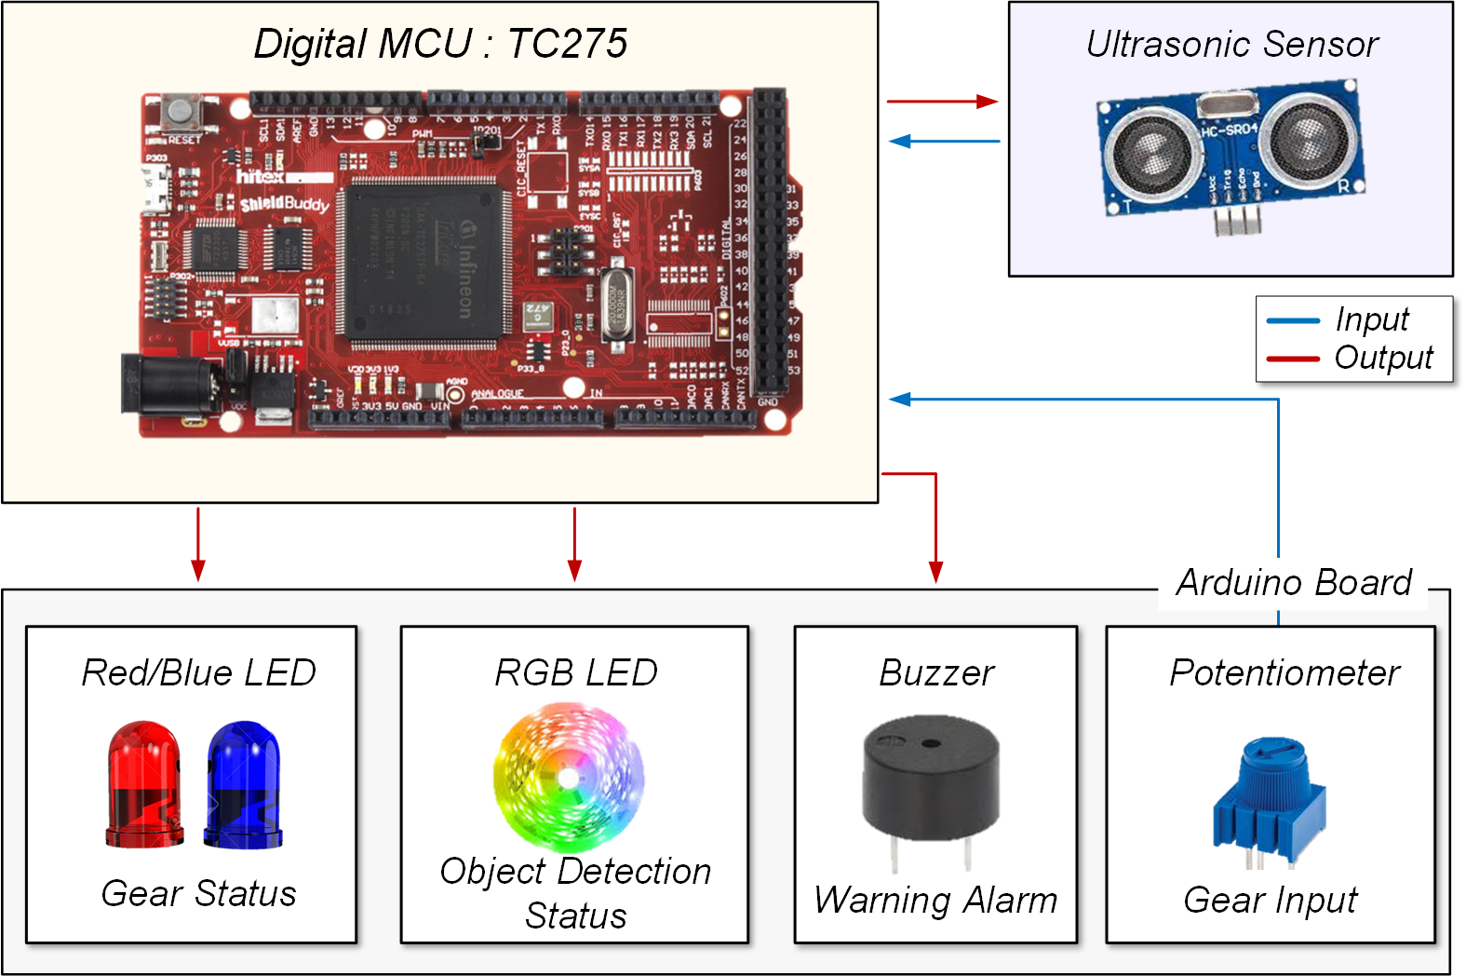
H/W & SW Configuration
①
②
① Digital MCU
② Ultrasonic
: Object detection
③ Red/Blue LED
: Gear Status
④ RGB LED
: Object Detection
Status
⑤ Buzzer
: Warning Alarm
⑥ Potentiometer
: Gear Input
③
④
⑤
⑥
[ Hardware Configuration ]

Slide 8
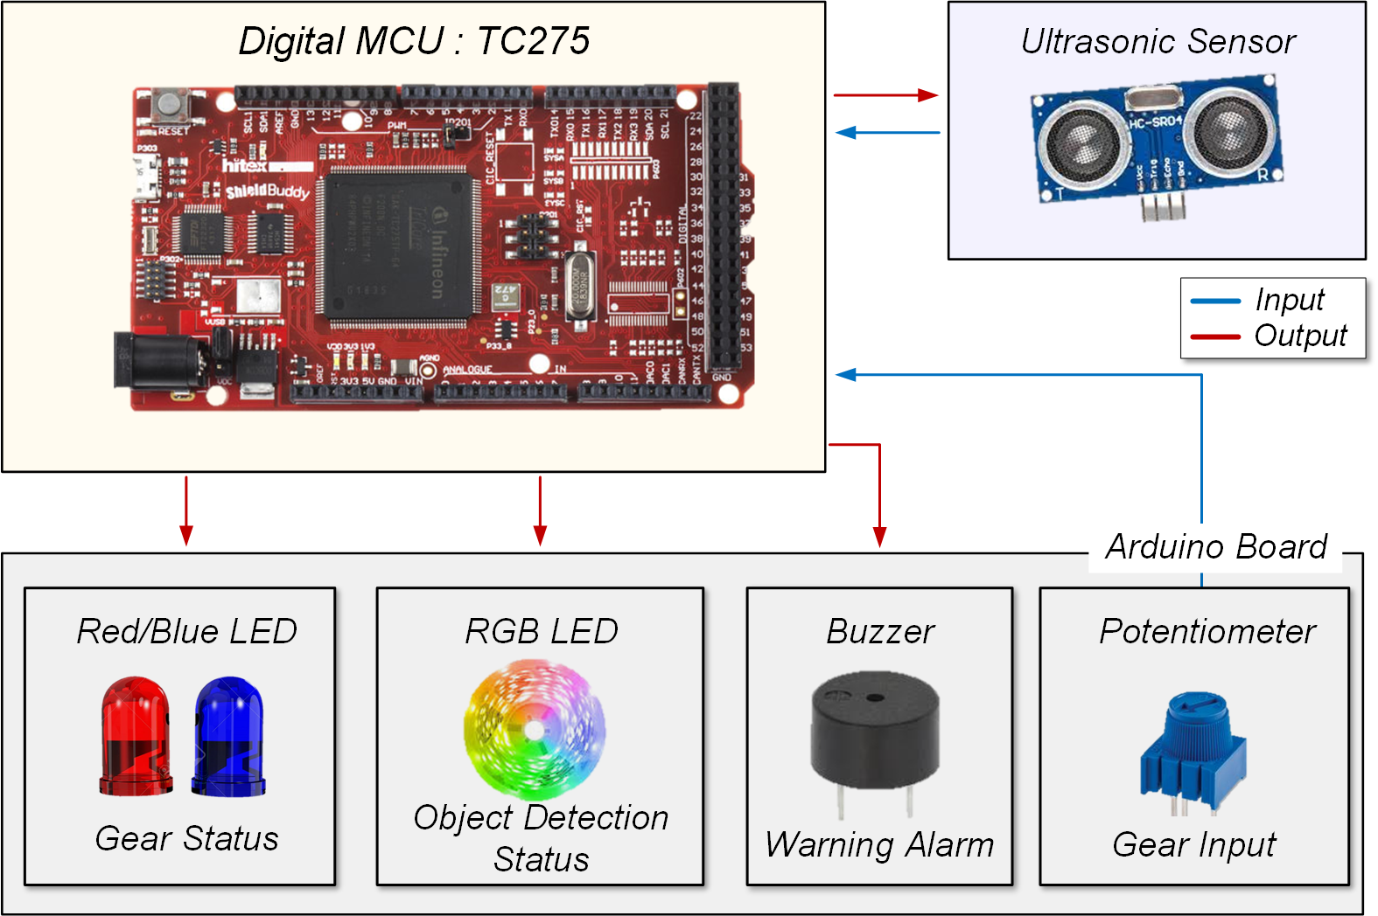
H/W & SW Configuration
Ultrasonic Sensor : Object Detection
: Triggered every 1msec for object detection / Echo signal is returned to the Digital MCU → Distance calculation.

Slide 9

H/W & SW Configuration
Potentiometer : Gear Input
: Rotating the potentiometer allows to select the gear. → 3 Status : Off / Drive (D) / Reverse (R)

Slide 10
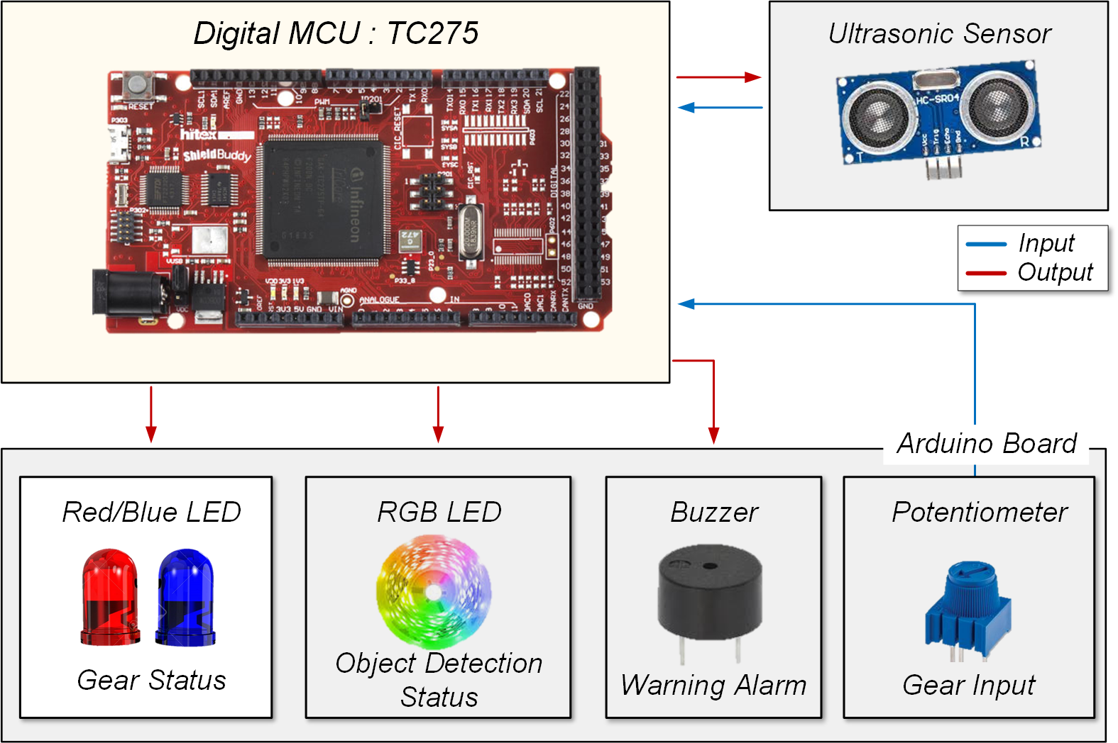
H/W & SW Configuration
Red/Blue LED : Gear Status
: Informs the status of the gear → Red : Drive / Blue : Reverse

Slide 11

H/W & SW Configuration
RGB LED : Object Detection Status
: Based on the distance, RGB LED shows the object detection status with 3 different color ( R / G / B )

Slide 12
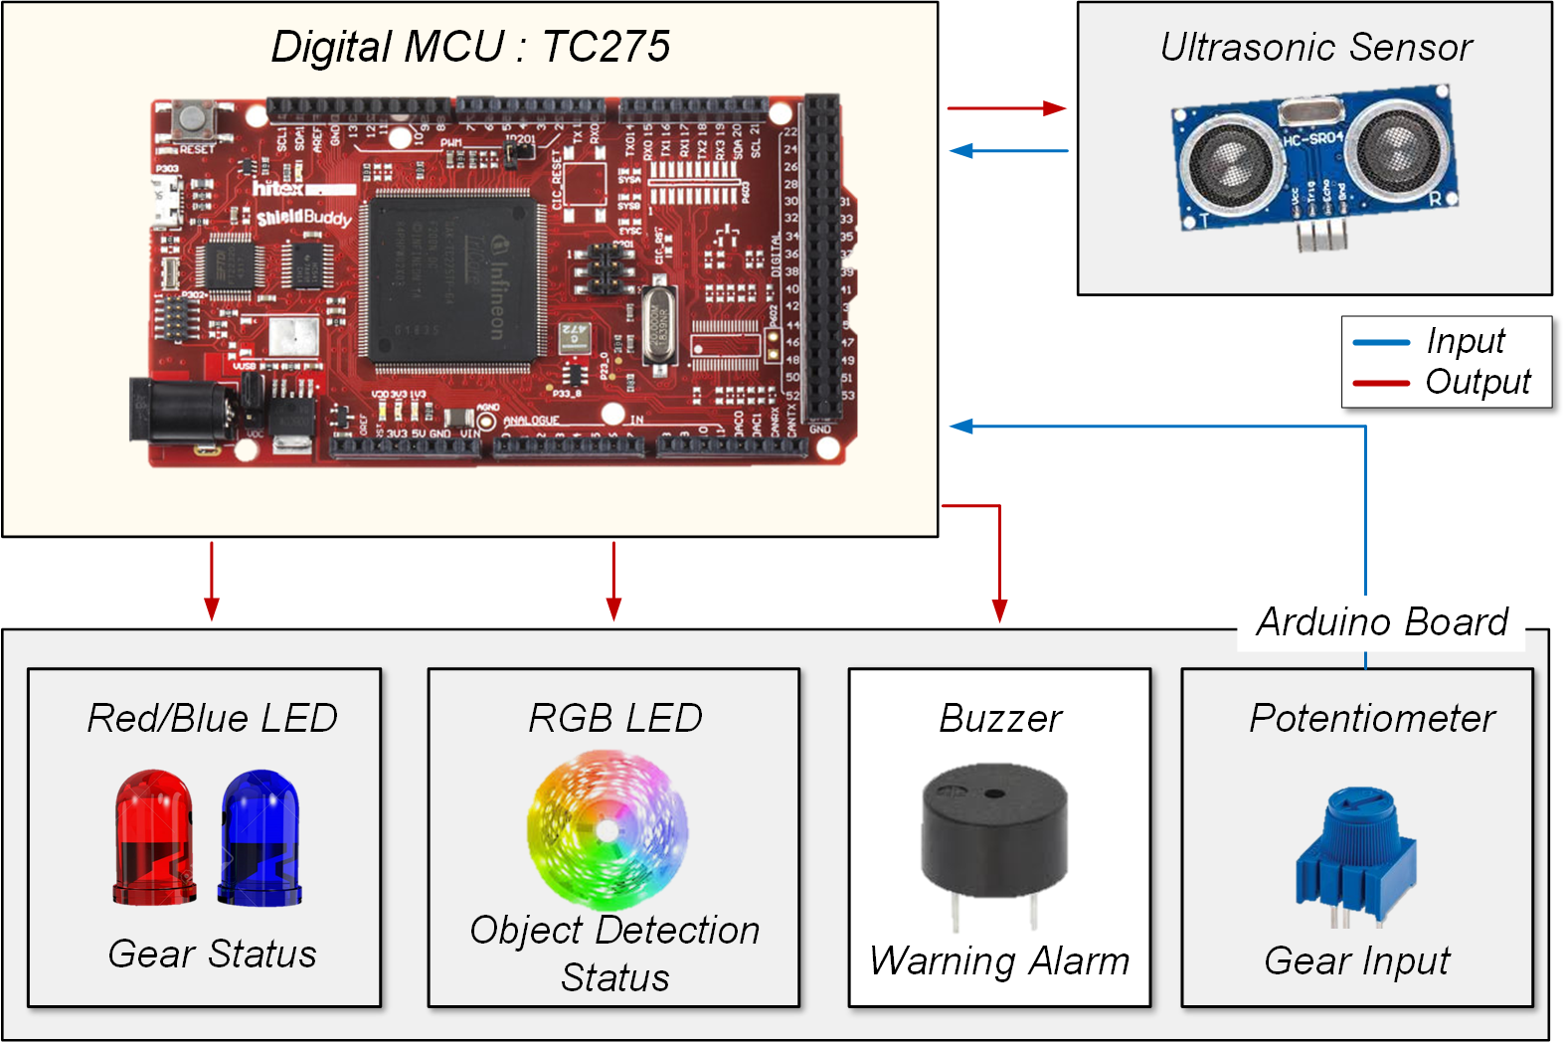
H/W & SW Configuration
Buzzer : Warning Alarm
: As the distance gets closer buzzer informs a warning signal. → Frequency of warning signal increases.

Slide 13
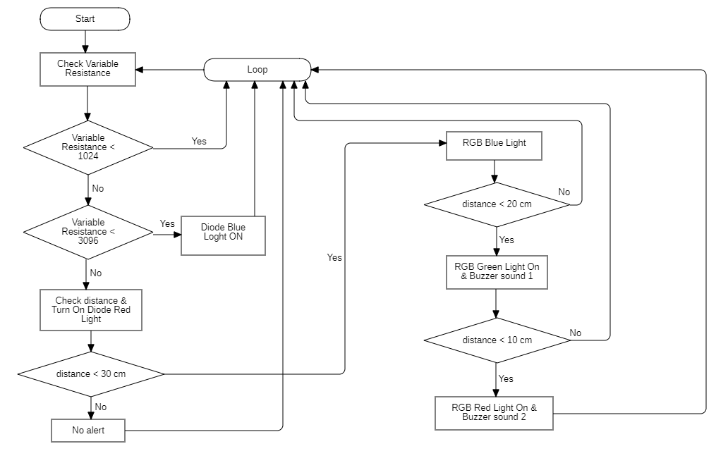
H/W & SW Configuration
Operation Flow Chart
① Parking Mode
② Drive Mode
③ Reverse Mode
[ Operation flow chart ]

Slide 14
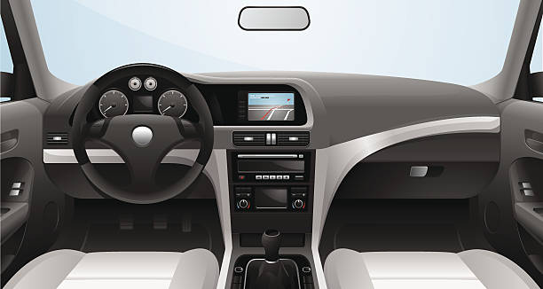
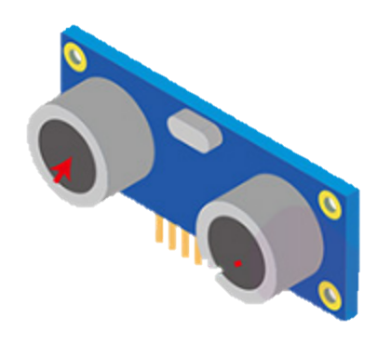
Demo Scenarios
Demo scenario 1.
Gear : P / N
All LEDs are off and no buzzer sounds.
[ Demo Scenario 1 ]

Slide 15

Demo Scenarios
Demo scenario 2.
Gear : D
The blue LED next to the gear turns on and no buzzer sounds.
[ Demo Scenario 2 ]

Slide 16

Demo Scenarios
Demo scenario 3.
Gear : R
Distance from an obstacle > 30 cm
The red LED next to the gear turns on and no buzzer sounds.
Obstacle
D > 30cm
[ Demo Scenario 3 ]

Slide 17

Demo Scenarios
Demo scenario 4.
Gear : R
30 cm > Distance from an obstacle > 20 cm
The blue LED on the left side of the HUD turns on and no buzzer sounds.
Obstacle
Still on
20 cm < D < 30cm
[ Demo Scenario 4 ]

Slide 18


Demo Scenarios
Demo scenario 5.
Gear : R
20 cm > Distance from an obstacle > 10 cm
The green LED on the left side of the HUD turns on and there is weak warning sounds.
Low tone warning sounds
Obstacle
Still on
10 cm < D < 20cm
[ Demo Scenario 5 ]

Slide 19

Demo Scenarios
Demo scenario 6.
Gear : R
Distance from an obstacle < 10 cm
The red LED on the left side of the HUD turns on and there is strong warning sounds.
High tone warning sounds
Obstacle
Still on
20 cm < D < 30cm
[ Demo Scenario 6 ]

Slide 20
Conclusion
Day1
Day2
Day3
Works | Team | Time (hour) |  |  |  |  |  |  |  |  | ETC
 |  | 1 | 2 | 3 | 4 | 5 | 6 | 7 | 8 | 9
Decision | Topic Selection : Rear Parking Collision-Avoidance Assist System |  |  |  |  |  |  |  |  |  | -
 | Device Selection |  |  |  |  |  |  |  |  |  | -
 | Performance Evaluation |  |  |  |  |  |  |  |  |  | -
Detection & Control | Coding for ultrasonic sensor |  |  |  |  |  |  |  |  |  | -
 | Coding for Led & RGB Led |  |  |  |  |  |  |  |  |  | -
 | Coding for Buzzer |  |  |  |  |  |  |  |  |  | -

Slide 21
Thank you

